Slide 1
Power BI Governance That Actually Works
Balancing self-service freedom with the control your organization needs
Robert Mondrik · 8th May 2026
Notes:
- Questions preferred in the end

Slide 2
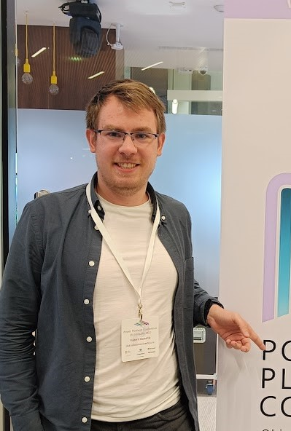
Speaker introduction
BI Consultant and Data Analysis Lecturer
In the Data field since 2018, mainly focused on Power Platform and technology data
Power BI lecturer since 2022
PL-300, DP-600 and DP-700 certifications
In my free time I like to travel, play board games and spend time outdoors

Slide 3
ISSUES WITH INCORRECT POWER BI GOVERNANCE

Slide 4
Two ways this goes wrong
Too Open
Too Locked Down
3-week queue to get a simple report change
IT becomes the bottleneck for everything
Users build it in Excel anyway
BI team is busy, business is frustrated
Mass number of reports, nobody knows which one is right
Duplicate datasets, conflicting numbers
Sensitive data shared with the wrong people
"Which sales figure should I trust?"

Slide 5
DEMO 1 — The Chaotic Workspace
Notes:
A joke about Hogwarts – not real organization but real problem
Workspace with multiple: duplicates, v1/v2/FINAL/FINAL REAL naming
Datasets with no description, stale refresh dates
Workspace access —people with Edit or Admin who shouldn't have it

Slide 6
DEMO 1 — The Chaotic Workspace
Workspace with multiple: duplicates, v1/v2/FINAL/FINAL REAL naming
Datasets with no description, stale refresh dates
Workspace access —people with Edit or Admin who shouldn't have it
Notes:
Hogwarts Analytics

Slide 7
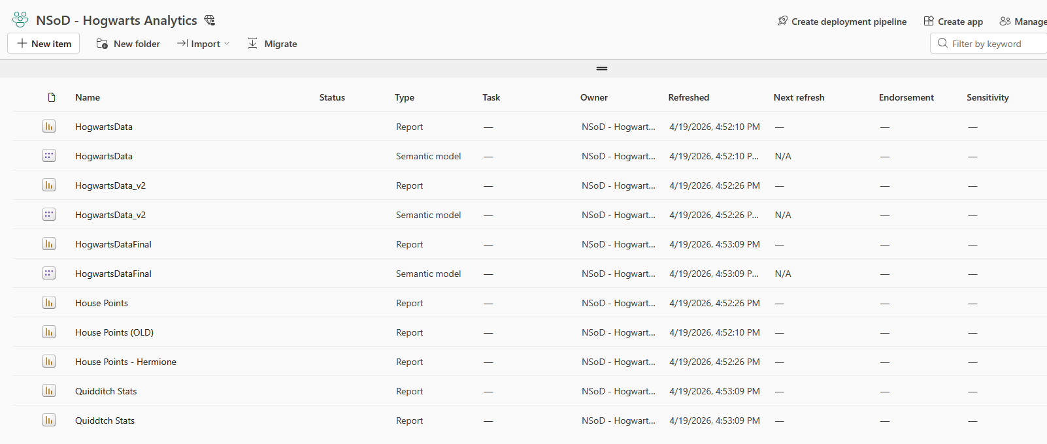
DEMO 1 — The Chaotic Workspace

Slide 8
Why getting governance right is genuinely difficult
Self-service BI was sold as the solution to IT bottlenecks
But freedom without structure creates its own problems
Business users want speed; IT wants control; security wants neither
There's no universal answer, context determines the model

Slide 9
Why both extremes cost you more than you think
No governance
Over-governance
Duplicate reports, no naming conventions, no trust in data
Security incidents happen silently (wrong people see sensitive data)
Unused reports cluttering the tenant
Sensitive data moves to email attachments and shared drives instead
Response to business requirements is too slow
Drive to improve reporting falters

Slide 10
OVERVIEW OF THREE MAIN GOVERNANCE MODELS

Slide 11
Three governance models — and when each fits
 | IT-centric | Federated | Self-Service
Who builds | IT only | IT + business | Business
Speed | Slow | Balanced | Fast
Control | High | Medium | Low
Best for | Regulated industries | Most organizations | High-maturity small orgs
Most organizations should be in the Federated column.
The question is exactly where on the spectrum.

Slide 12
The IT-centric model
What it looks like
When it fits
Central IT owns all datasets, reports, and dashboards
Business users are consumers only (no self-service building)
All changes go through a formal request and approval process
Strong version control, change management, audit trails
Highly regulated industries (finance, healthcare, government)
Very sensitive data, low risk tolerance
Organizations with low data literacy across business units

Slide 13
The full self-service model
What it looks like
When it fits
Anyone can build and publish reports freely
Minimal central oversight or approval
Business units own their own workspaces and data
IT provides tools and training, not content
Small organizations with high data literacy
Low-sensitivity data environments
Strong existing culture of data ownership and accountability

Slide 14
The federated model — the realistic middle ground
Four layers:
1. Certified data layer — owned and maintained by IT/data team, endorsed, trusted
2. Enterprise reports — IT/BI built, formal, certified, broad audience
3. Self-service reports — business built, on top of the same certified data
4. Personal / exploratory — My Workspace, no guarantees, not for production
Key principle: Govern the data layer tightly. Give flexibility above it.
Self-service doesn't mean building your own data. It means building your own reports on trusted data.

Slide 15
How to set up correct governance

Slide 16
DEMO 2 — Admin Portal: Tenant Settings
Notes:
Workspace creation: "All users" → recommend specific security groups
Publish to web: On → recommend Off
External sharing: On → Off (instead invite people to your tenant)
Certification: who can certify datasets → designated certifiers, not just admins
Sensitivity labels: Optional → Required on publish

Slide 17
DEMO – Tenant Settings: admin portal (backup)
Workspace creation: "All users" → recommend specific security groups
Publish to web: On → recommend Off
External sharing: On → Off
Certification: who can certify datasets → designated certifiers, not just admins
Sensitivity labels: Optional → Required on publish

Slide 18
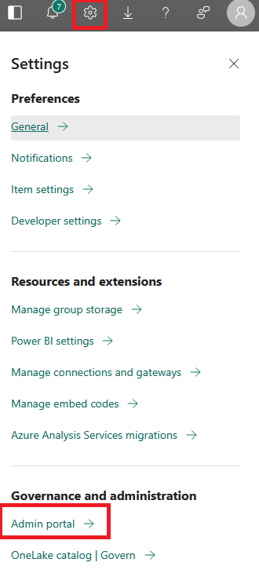
DEMO – Tenant Settings: admin portal (backup)

Slide 19
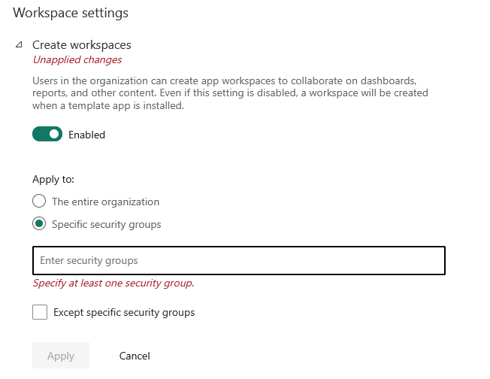
DEMO – Tenant Settings: admin portal (backup)
Workspaces should be created only by specific people or security groups
Not by any business user

Slide 20
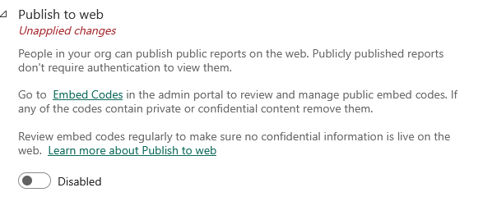
DEMO – Tenant Settings: admin portal (backup)
Unless specific business needs require publishing to web, disable to it to prevent data leaks

Slide 21
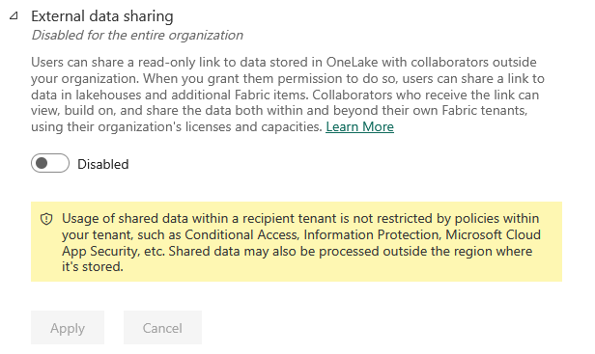
DEMO – Tenant Settings: admin portal (backup)
Data can leak outside of organization

Slide 22
DEMO – Tenant Settings: admin portal (backup)
Data can leak outside of organization

Slide 23
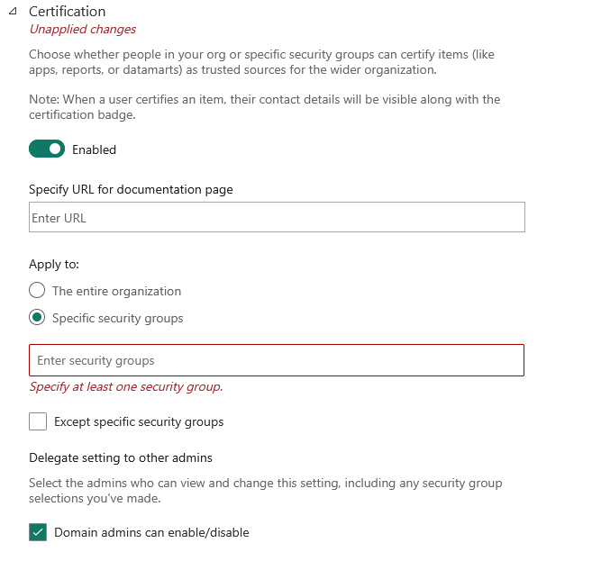
DEMO – Tenant Settings: admin portal (backup)
Certification is enabled but only four specific people or security groups

Slide 24
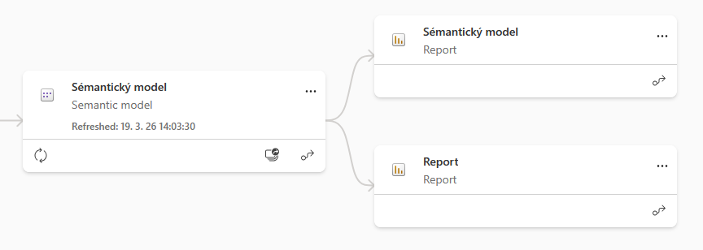
Separating semantic models from reports

Slide 25
Separating semantic models from reports
IT governed Semantic model ready to be built upon by business
One semantic model feeds many report workspaces meaning no duplication at the data layer
Workspace containing only semantic models without access for anyone except PBI Admins
Report builders get Build permission on the dataset, not access to the model workspace
Enterprise and self-service reports coexist without one polluting the other
Lineage stays clean, you always know what depends on what

Slide 26
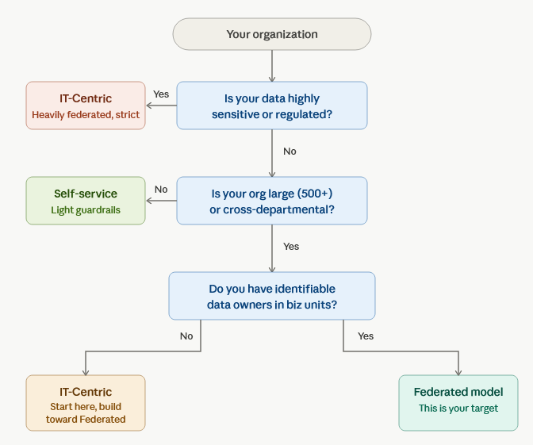
Choosing the right model for your organization

Slide 27
From my experience
What works
And what doesn’t
Start with the data layer, not the report layer. One shared semantic model is a great start
Find your Data Stewards early (one person per business unit who owns governance in their area)
Make the governed path the path of least resistance and greatest results
Governance written but not actively enforced
„This time we can avoid governance to get things done faster“
IT owning it alone. The business must participate.

Slide 28
DEMO 3 — The Governed Environment, concrete steps
Notes:
Clean workspaces: Hogwarts · Core Data, Gryffindor · Reports, Slytherin · Reports
Certified dataset in Core Data: owner, contact, refresh schedule, endorsement badge
Lineage view (in Gryf/Slyth workspace): one dataset → enterprise report + self-service report
Workspace access: data team owns Core Data, house heads own their report workspace
RLS: View as role → Slytherin_Head → only Slytherin students visible. Switch to Headmaster → all 40 students. One report, one dataset, different data per user.

Slide 29
DEMO 3 — The Governed Environment
Clean workspaces: Hogwarts · Core Data, Gryffindor · Reports, Slytherin · Reports
Certified dataset in Core Data: owner, contact, refresh schedule, endorsement badge
Lineage view: one dataset → enterprise report + self-service report
Workspace access: data team owns Core Data, house heads own their report workspace
RLS: View as role → Slytherin_Head → only Slytherin students visible. Switch to Headmaster → all 40 students. One report, one dataset, different data per user.

Slide 30
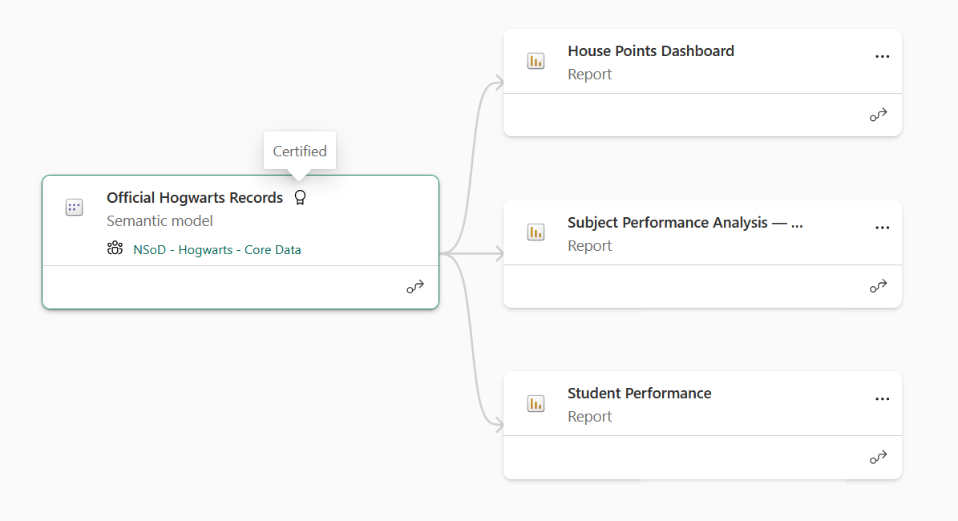
DEMO 3 — The Governed Environment

Slide 31
Where to start — immediate actions
Audit your tenant: what exists, who owns it, what's shared externally
Fix the 3–4 critical tenant settings (publish to web, external sharing)
Analyze current data structure and most used data models

Slide 32
Where to start — foundation
Define a workspace, reports, SM, naming convention and enforce it
Prepare and certify your core semantic moels
Identify Data Stewards in key business units

Slide 33
Where to start — structure
Implement governance step by step
Deploy Row-Level Security on sensitive datasets
Define and publish your endorsement process
The rule: Fix what's broken first. Build what's missing second.

Slide 34
Three things to take away
In the beginning lean towards IT-centric governance and as the users mature give the more responsibilities
Govern the data layer tightly. Give flexibility above it. Separate your semantic models from your reports.
Start small, don’t rebuild everything once. It is important not to overwhelm business users with governance from start.

Slide 35
Big thanks
Thank you for attending this session
Thanks to the organizers Ben and William
Thanks to my mentor Abhi Jayanty

Slide 36
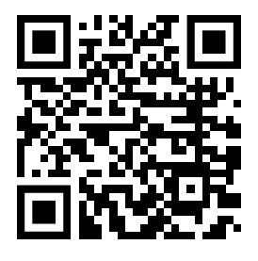
LI Qr code

